Slide 1
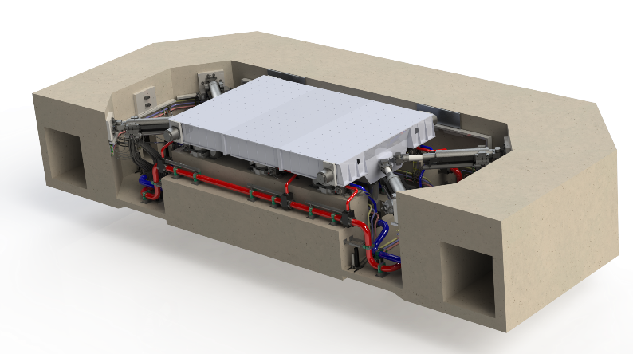
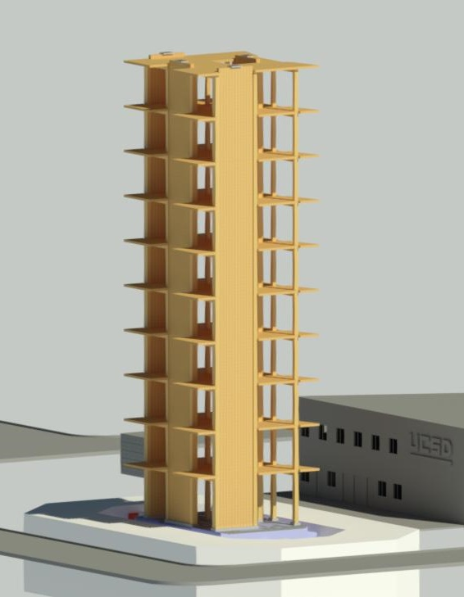
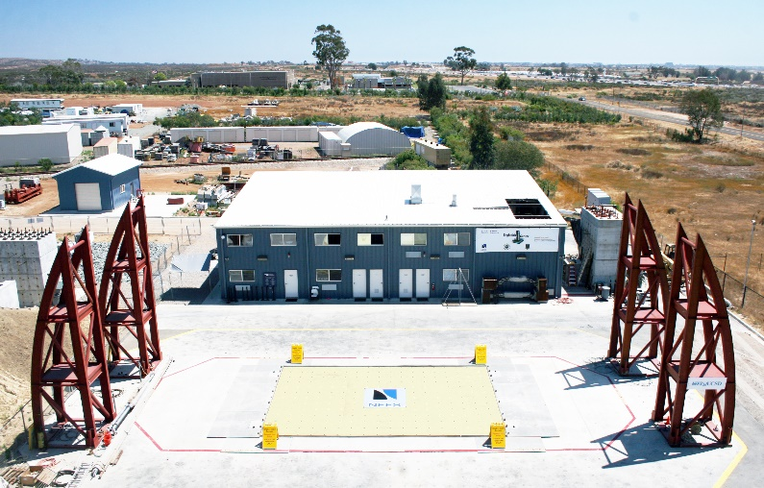
BREAKOUT SESSION #3 Timber/Woodframe Building Structures
National Science
Foundation
John van de Lindt, Professor, Colorado State University
Chao-Hsien Li, Graduate Student, UCSD
Joint Academia-Industry NHERI Workshop
NHERI@UC San Diego
September 21-22, 2020 University of California, San Diego

Slide 2
Participants
John van de Lindt, Professor, Colorado State University
Larry Stevig, Principal Researcher, State Farm
Steve Pryor, Advanced Research Manager, Simpson Strong-Tie

Slide 3
Identified Priority Research Areas
Systematic research program to develop inexpensive responses modification devices
Simplify code provisions for implementation in LFW
Utilize vertical components
Development of improved design provisions for wood buildings with reasonable cost
ATC116-increasing strength and stiffness
Short-period building focused
Functional recovery of wood buildings
Structural/nonstructural components
Identify required building performance levels to achieve community resilience goals

Slide 4
Academia-Industry Collaboration Opportunity
Development of commodity and proprietary products will require industry-academia collaboration

