Slide 1
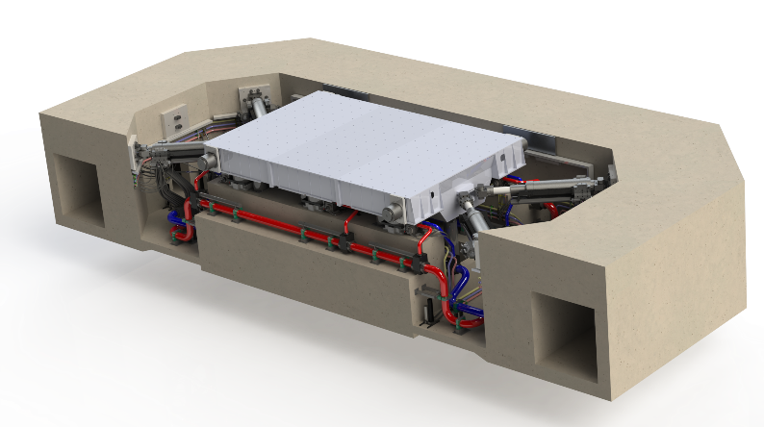
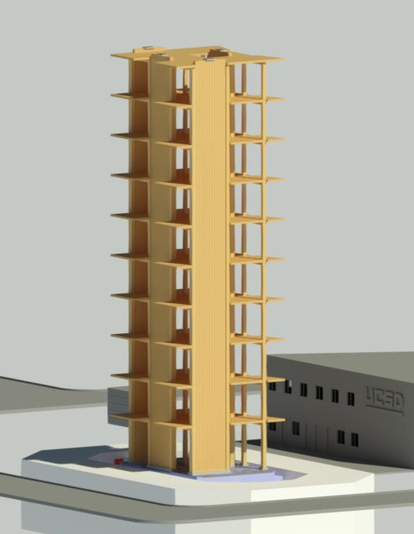
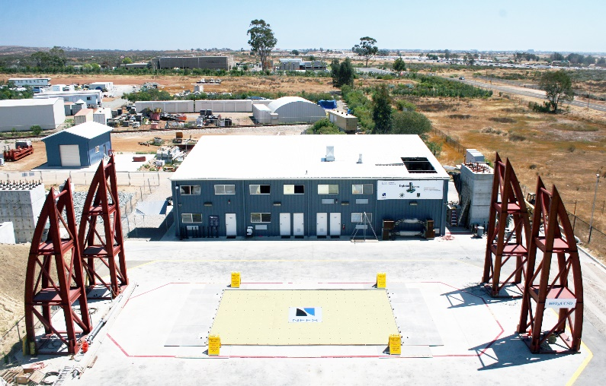
BREAKOUT TOPIC: BRIDGES
National Science
Foundation
Anthony Sanchez, SYSTRA IBT
Jianyu Cheng, UC San Diego
Joint Academia-Industry NHERI Workshop
NHERI@UC San Diego
September 21-22, 2020 University of California, San Diego

Slide 2
Bridge Breakout Participants
Anthony Sánchez, SYSTRA IBT (Moderator)
Jianyu Cheng, UC San Diego (Scribe)
Charly Sikorsky, Caltrans Retired, ITS Berkeley
Petros Sideris, Asst Prof Texas A&M, Low damage bridge systems

Slide 3
Top Three Bridge Research Topics
Damage Resistant Bridge Systems
Foundation Rocking
Durability Topics

Slide 4
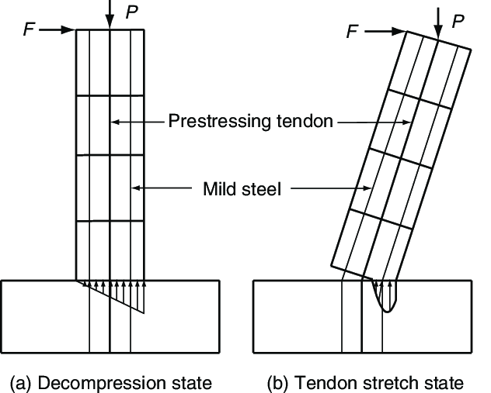
Bridge Topic 1 Discussion: Damage Resistant Design (Unbonded PT in columns, Sliding and rocking joints)
Ref: UCSD, UNR, Texas A&M, Univ. Wash, Buffalo
Have been tested before, but no clear path on how to implement into practice.
Difficult to convince DOT’s that it will be beneficial
Field demonstration projects are difficult to implement. EQ don’t happen often.
Need full/large-scale testing
Funding for testing is difficult to obtain: Shake table testing is expensive: $1M to $2M per test?
DOT’s and State Bridge Engineers are comfortable with current design methods.
Will take time to convince DOT’s to do the testing
How much money can be saved? Desktop study based on past earthquakes?
This could show the monetary benefit of the new damage resistant designs.
Other benefit: Reduce traffic impacts (can reopen bridges quickly post EQ)

Slide 5
Bridge Topic 2 Discussion: Foundation Rocking
Rocking can dissipate energy and reduce damage to columns
Current mindset is to avoid foundation rocking
Could have applications to ABC
Need more research to:
Prove reliable performance and stability
Devlop easy to implement design methodologies
Cold joint
Conventional System (Monolithic)
Rocking System

Slide 6
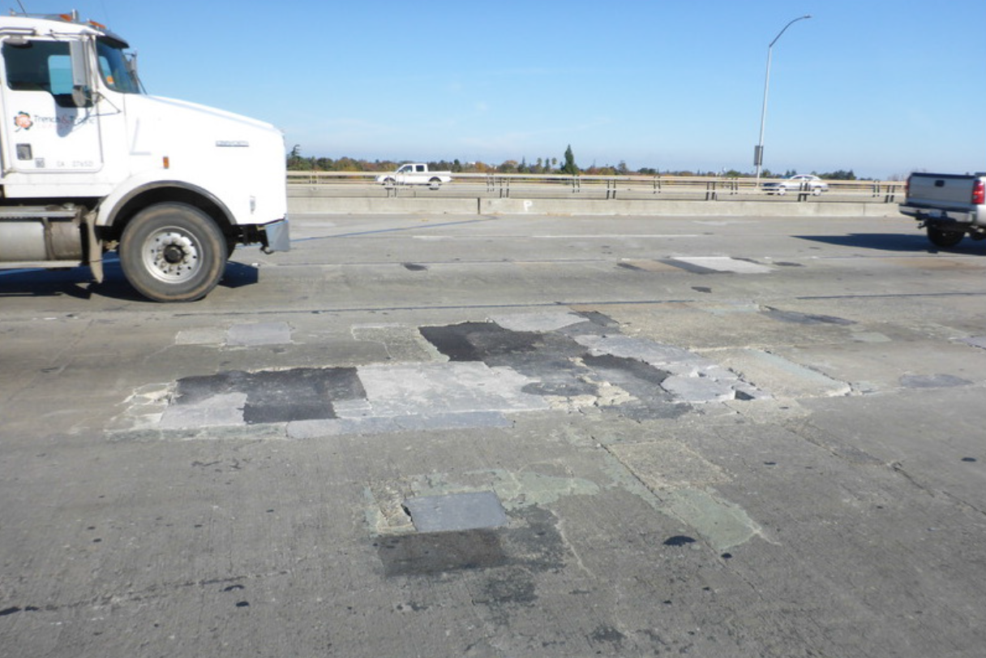
Bridge Topic 3 Discussion: Durability
UHPC for Bridge Decks
Important topic, but not applicable to LHPOST
Long-term degradation testing for topics 1 and 2
Exposed to elements
Live load testing on shake table:
Simulate live load deflections and durability of bridge decks,
Fatigue in steel members

Slide 7
Bridge Research Potential Funding Sources
State DOT’s:
Caltrans
Oregon DOT
Wash DOT
Alaska DOT
Hawaii DOT
Idaho DOT
Utah DOT
FHWA

Slide 8
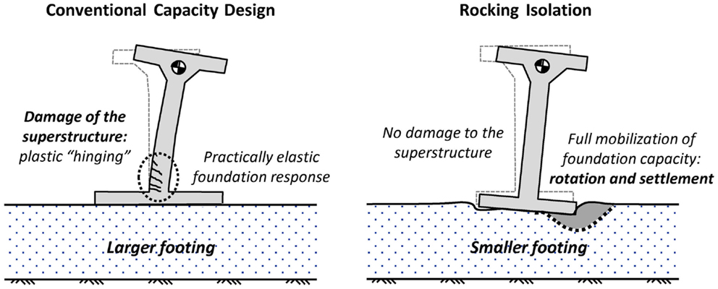
Summary Slide: BRIDGES
Topic 1: Damage Resistant Bridge Systems
Not well understood by DOT’s
State bridge engineers are comfortable with current ductility methods
What are the benefits?: long-term cost savings, reduced traffic impacts post EQ
Topic 2: Foundation Rocking
Perceived as a retrofit technique
Need more testing to show that it’s reliable, saves cost, reduces damage, develop easy to implement design methods
Topic 3: Durability Topics
UHPC for bridge decks
Live load testing for long term durability, fatigue in steel members
Long term degradation, then retesting of items 1 and 2 above

